Slide 1

TIC and Related Technologies
Discover the fascinating world of Information and Communication Technologies (TIC) and technologies associated with TIC, such as Google services, Microsoft tools, Git, and GitHub. This report explores various aspects of these technologies and their impact on our lives.

Slide 2


Content Table
I.Introduction
II.Google Services
III. Microsoft Tools
IV. Git and GitHub
V. Futer Trend
VI. Conclusion

Slide 3

I. Introduction
TIC, comprising tools like Google Services, Microsoft Tools, Git, and GitHub, is the linchpin of modern connectivity and innovation. These technologies redefine global communication, optimize business workflows, and drive collaborative software development. From Google's Workspace and Cloud Platform to Microsoft's 365 and Azure, alongside Git's version control and GitHub's hosting, these tools collectively shape how we operate in the digital age, fostering efficiency and transformative advancements across diverse sectors.

Slide 4
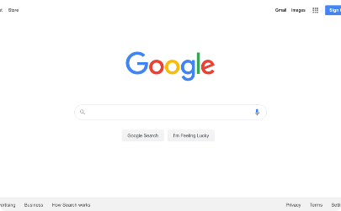
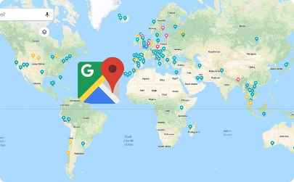
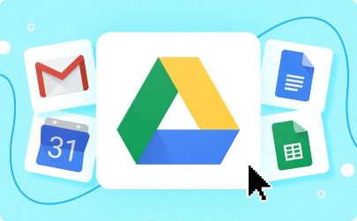
Google Services: A Gateway to Possibilities
Innovative Search Capabilities
Navigation & Exploration
Effortless Collaboration
Explore the immense power of Google's search engine, enabling users to access a vast sea of information and uncover knowledge at their fingertips.
Embark on virtual journeys with Google Maps, allowing users to discover new places, navigate smoothly, and even experience street views from around the world.
Maximize productivity and teamwork using Google Drive, a versatile platform offering collaborative document editing, cloud storage, and real-time synchronization.

Slide 5

Microsoft Tools: Empowering Productivity
Excel - Master Data Analysis
PowerPoint - Dynamic Presentations
Teams - Seamless Collaboration
Unleash the power of Microsoft Excel to analyze complex data sets, create visualizations, and make data-driven decisions with confidence.
Create captivating presentations with Microsoft PowerPoint, ranging from slide decks to interactive multimedia experiences that engage and impress your audience.
Effortlessly connect and collaborate with colleagues using Microsoft Teams, a robust platform that integrates chat, video calls, file sharing, and project management.

Slide 6

Git and GitHub: Mastering Version Control
1
Introduction to Git
Learn the fundamentals of Git, a distributed version control system that tracks changes in files, promotes collaboration, and enables seamless code management.
2
Exploring GitHub
Discover the power of GitHub, a web-based hosting service designed for version control, code management, issue tracking, and collaborative development.
3
Contributing to Open Source
Join the global community of developers on GitHub by contributing to open-source projects, honing your skills, and making a positive impact on the software ecosystem.

Slide 7

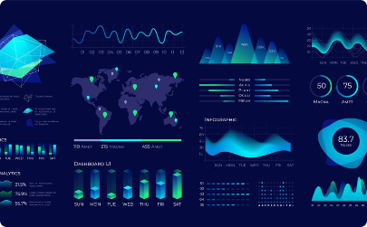
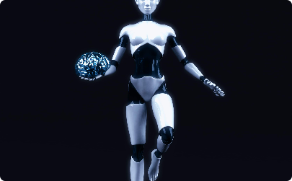
Future Trends
Rise of Automation
Advancements in Machine Learning
Ethics and Responsible AI
Discover how automation technologies, powered by AI, are reshaping industries and transforming the way businesses operate.
Learn about the latest developments in machine learning algorithms and techniques, and how they are enabling smarter decision-making and predictive analytics.
Explore the growing importance of ethical considerations in AI development and deployment, and the need for responsible AI practices.

Slide 8

Conclusion: Embracing the Future
As we conclude this exploration of TIC and related technologies, it is important to remember that this is just the beginning. The world of technology is constantly evolving, and it is crucial to stay updated and continue learning. With the knowledge gained from this journey, embrace the future with confidence and curiosity.

